Slide 1

Getting started with Verilator
Made by M.KASHAF KHAN
Dated: 11 / April / 2024

Slide 2
Table of contents
Introduction to Verilator
Verilator Vs Other Compilers and EDA Tools
Installation
Running our first program
Conclusion

Slide 3
Introduction to Verilator
The Verilator package converts Verilog and SystemVerilog HDL designs into a C++ or SystemC model that, after compiling, can be executed. Verilator is not a traditional simulator but a compiler.

Slide 4
Verilator Vs Other Compilers and EDA Tools
1. Fast
➔ Outperforms many closed-source commercial simulators
➔ Single- and multithreaded output models
2. Widely used
➔ Wide industry and academic deployment
➔ Out-of-the-box support from Arm and RISC-V vendor IP
3. Community Driven & Openly Licensed
➔ Open, and free as in both speech and beer
➔ More simulation for your verification budget
4. Commercial Support Available
➔ Commercial, design and enhancement support contracts
5. Comparison
( according to web )
Verilator has typically similar or better performance versus closed-source Verilog simulators (e.g., Carbon Design Systems Carbonator, Modelsim/Questa, Cadence Incisive/NC-Verilog, Synopsys VCS, VTOC, and Pragmatic CVer/CVC). But, Verilator is open-sourced, so you can spend on computes rather than licenses. Thus, Verilator gives you the best simulation cycles/dollars.

Slide 5
Installation
Git Quick Install
Commands:
-------------------------------------------------------SETTING UP VERILATOR---------------------------------------------------------
# Prerequisites:
# sudo apt-get install git help2man perl python3 make autoconf g++ flex bison ccache
# sudo apt-get install libgoogle-perftools-dev numactl perl-doc
# sudo apt-get install libfl2 # Ubuntu only (ignore if gives error)
#sudo apt-get install libfl-dev # Ubuntu only (ignore if gives error)
#sudo apt-get install zlibc zlib1g zlib1g-dev # Ubuntu only (ignore if gives error)
git clone https://github.com/verilator/verilator # Only first time
# Every time you need to build:
unsetenv VERILATOR_ROOT # For csh; ignore error if on bash
unset VERILATOR_ROOT # For bash
cd verilator
git pull # Make sure git repository is up-to-date
git tag # See what versions exist
# git checkout master # Use development branch (e.g. recent bug fixes)
# git checkout stable # Use most recent stable release
# git checkout v{version} # Switch to specified release version
autoconf # Create ./configure script
./configure # Configure and create Makefile
make -j `nproc` # Build Verilator itself (if error, try just 'make')
sudo make install

Slide 6
→ Now open your terminal and create a workplace for your files.
→ Open your code editor (VS CODE in my case) and create two test files for compilation and simulation.
→ I’m creating test.sv (design file) and test_tb.sv (testbench file).
//////////////// VERILOG CODE FOR A DFF ///////////////////
`timescale 1ns / 1ps
module test
(
input logic clk, // clock
input logic reset, // reset (Active HIGH)
input logic in, // input bit stream
output logic y // output of D FlipFlop
);
always_ff @(posedge clk)
begin
if(reset)
y <= 1'b0;
else
y <= in;
end
endmodule : test
//////////// TESTBENCH OF DFF /////////////////////
`timescale 1ns / 1ps
module test_tb ();
/* verilator lint_off UNUSEDSIGNAL */
/* verilator lint_off WIDTHTRUNC */
logic clk;
logic reset;
logic in;
logic y;
test DUT (
.clk(clk),
.reset(reset),
.in(in),
.y(y)
);
//generating CLOCK
always #10 clk <= ~clk;
// input stimulus
initial begin
reset = 1;
repeat(10) @(posedge clk);
reset = 0;
repeat(100) begin
@(posedge clk)
in = $urandom();
end
repeat(10)
@(posedge clk);
$finish;
end //generating the VCD file for waveform viewing
initial begin
$dumpfile("dump.vcd");
$dumpvars();
end
endmodule : test_tb
test.sv file
test_tb.sv file

Slide 7
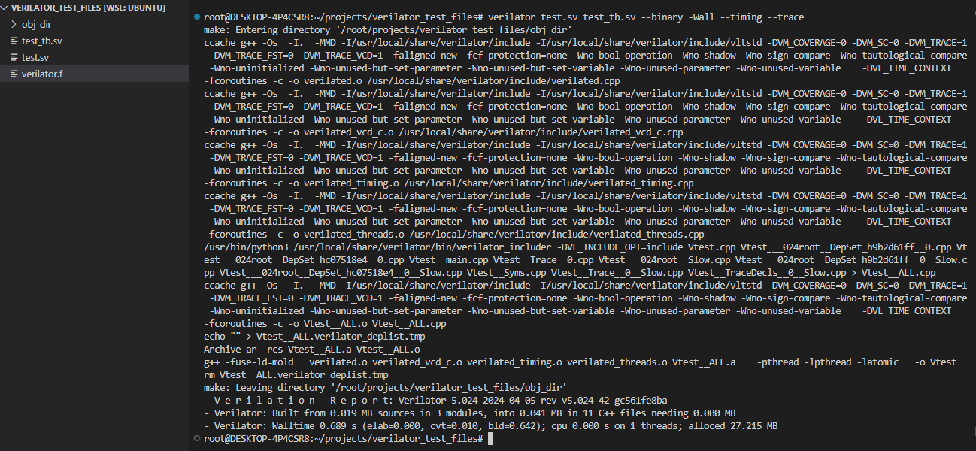
→ After creating the files, hop onto your terminal , save both the files and run the following command to compile your design:
verilator test.sv test_tb.sv --binary -Wall --timing --trace
→ This will compile your design and will put the generated files in the obj_dir folder.
→ Lets break this command even further down:
verilator: invokes the compiler
--binary: generates the executable CPP and binary files
-- timing: enabls timing support
-- trace: enables waveform creation

Slide 8
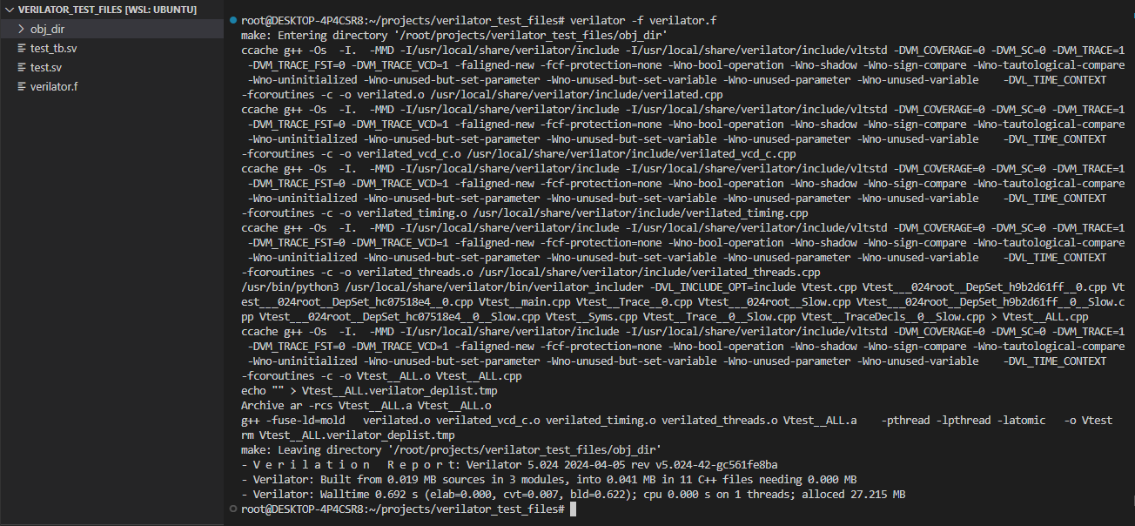
→ Instead of running this LONG command , we can make a separate file for commands and call it to run the same command in a very convenient manner:
→ We’ll name this file ‘verilator.f’
// design file
test.sv
// testbench file
test_tb.sv
// Build binary model (generates the executable CPP and binary files)
--binary
// checks only the syntax / good writing practices
//--lint-only (USE ANY ONE AMONG '--binary' OR '--lint-only')
// enable all style warnings
-Wall
// enable waveform creation
--trace
// enable timing support (for delays , wait, ....)
--timing
→ Now we’re going to run the command : verilator -f verillator.f
→ This will result in same compilation output as previous.
verilator.f file

Slide 9
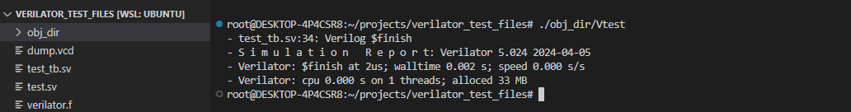
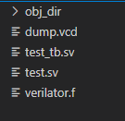
→ After compilation, we’re going to simulate the design using the command: ./obj_dir/Vtest
→ This means, in the obj_dir directory, run the ‘Vtest’ file present.
→ The name of the executable file is generally made as : V[design_filename].
→ After executing this command, our design is simulated.
→I’ve also dumped the output waveforms of my design in a file namely ‘dump.vcd’ in my testbench, so the dump.vcd file is generated in my directory also.
→I can now open a wave viewer (GTKWAVE in my case) to view the output waveforms.
→Running the command : gtkwave.exe dump.vcd
Will open GTKwave for me to view the waveforms.

Slide 10
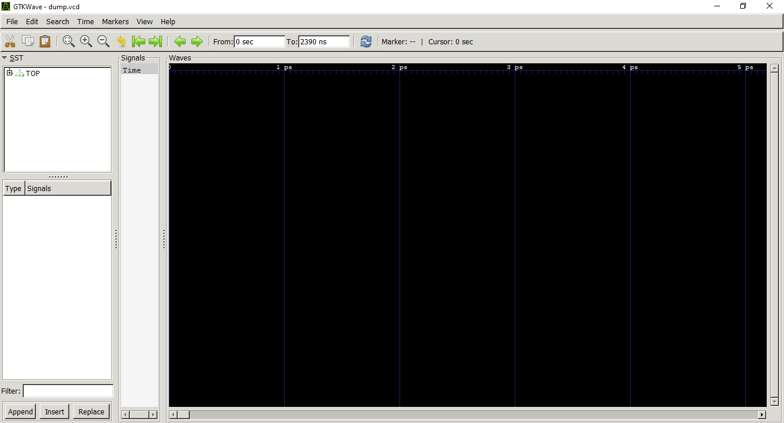
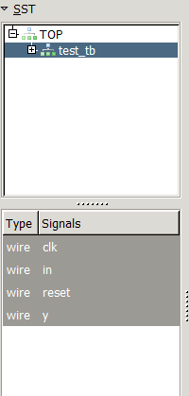
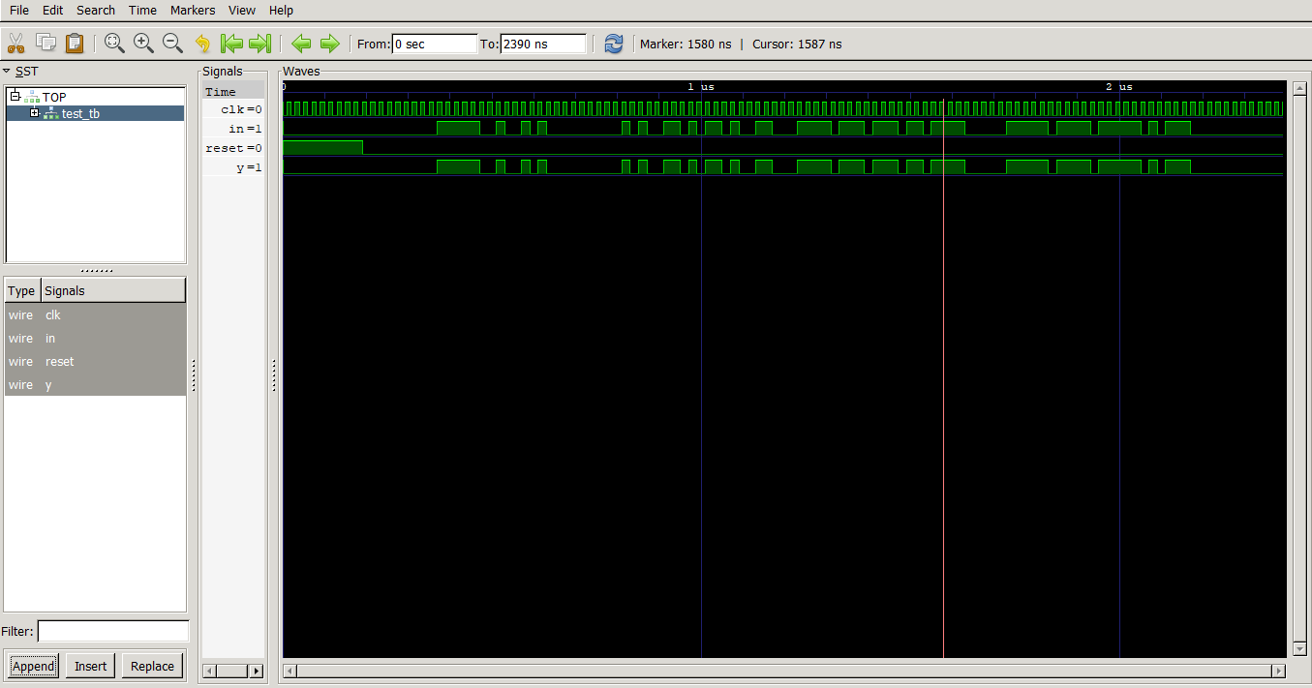

→GTKwave window:
2. Now select all the signals you want to see.
1. Select the TOP and open it to show the test_tb port signals
3. After selecting the signals , hit Append
4. You can see the waveforms now. Press ‘ctrl + 0’ to ZOOM FULL.

Slide 11




Running time comparison (FIFO)
Number of times repeated: 5,00,000 (Five Hundred Thousand)
Verilator | Modelsim
Compilation
Compilation
Simulation
Simulation
Verilator

Slide 12




Running time comparison (Seq_Det_1001)
Number of times repeated: 5,00,000 (Five Hundred Thousand)
Verilator | Modelsim
Compilation
Compilation
Simulation
Simulation

Slide 13




Running time comparison (4x1 Mux)
Number of times repeated: 1 (One)
Verilator | Modelsim
Compilation
Compilation
Simulation
Simulation

Slide 14
Conclusion
In this presentation, we got a quick glance on:
→ How to set verilator on your machine.
→ Essential commands required for running the files.
→ Compiling and simulating your design.
→ Observing output waveforms on GTKwave.
→ Compilation and Simulation speed Comparison

